Slide 1
Cyclone Casualty and Property Loss Prediction
St. Thomas’ College of Engineering and Technology
Team Members:
Satarupa Das (14)
Srijit Sarkhel (60)
Pratiksha Naskar (41)
Sayan Das (15)
Project Mentor : Amit Dutta

Slide 2
Introduction
Cyclones pose significant risks to life and property, particularly in India's coastal regions. To address this challenge, our research focuses on developing a predictive model for cyclone casualties and property loss in India.
Our dataset integrates population and GDP data for all states with historical cyclone data spanning five decades. Leveraging advanced machine learning techniques, including Linear Regression, Random Forest, XGBoost, and Light GBM, we train and test our model to accurately forecast cyclone impacts.
Our model aims to enhance cyclone preparedness and disaster management in India, ultimately reducing the impact on vulnerable communities.

Slide 3
Tools and Platform
Programming Language: Python
Libraries and Frameworks: NumPy, Pandas
Machine Learning Libraries: Scikit-learn
Data Visualization Tools: Matplotlib
Graphical User Interface (GUI) Development Frameworks: Tkinter, Gradio, Streamlit Development Environment: Visual Studio Code, JupyterNotebook

Slide 4
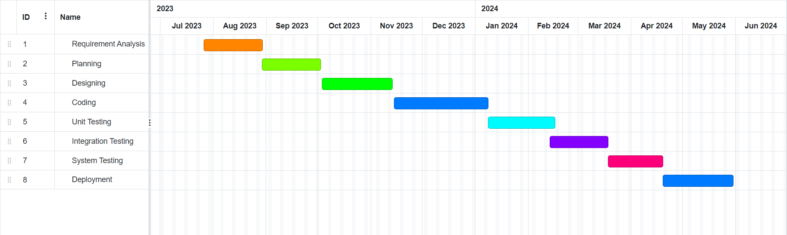
Project Plan

Slide 5



System Block Diagram
Data Preprocessing
Training Set
ML Model 1
Testing Set
ML Model 2
Input
Best Model
Output

Slide 6
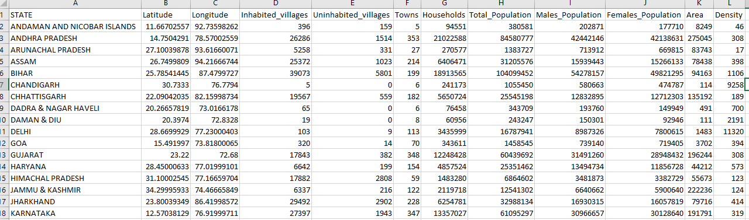
Datasets
Population Dataset:
The population dataset encompasses demographic information for all states of India. It includes data such as total population counts, gender demographics (male and female populations), and household statistics.

Slide 7
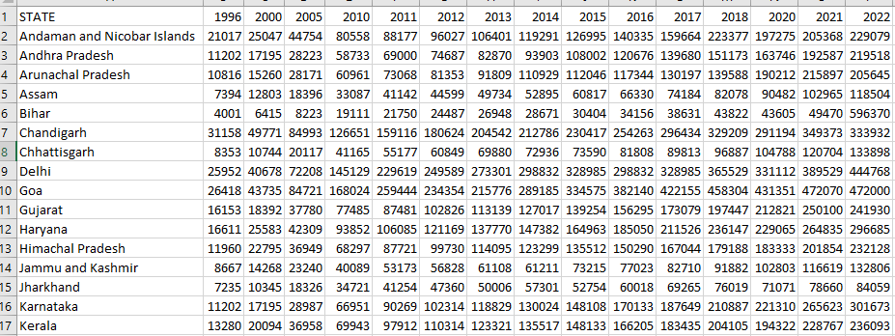
Datasets
GDP Dataset:
The GDP dataset comprises economic indicators for all states of India. It includes GDP values or economic output measures for each state, offering insights into the economic status and resilience of different regions.

Slide 8
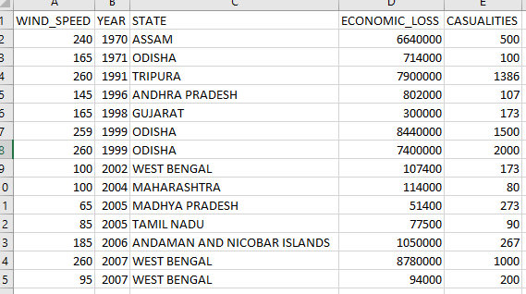
Datasets
Historical Cyclone Dataset:
The historical cyclone dataset spans a period of 50 years and contains comprehensive information about past cyclones that have affected India. This dataset includes details such as cyclone tracks, intensity, duration, affected regions within each state, and associated casualties and property losses.

Slide 9
Data Preprocessing
Handle missing values: Identify and address missing values in each dataset. This involve imputation techniques such as mean, median etc.
Remove duplicates: Check for and eliminate any duplicate records in the datasets to ensure data integrity.
Handle outliers: Detect and handle outliers that may skew the analysis or model performance. Depending on the nature of the data.

Slide 10
Method - 1

Slide 11
Methodology
Here gathered three essential datasets: Population data for all states, GDP data for all states, and a Historical Cyclone dataset spanning 50 years, including casualty and property loss information and the effected regions of the state’s due to the cyclones. we successfully integrated three crucial datasets—Population, GDP, and Historical Cyclone—creating a comprehensive dataset essential for subsequent model development. Subsequently, we employed various machine learning models, including Linear Regression, Random Forest, XG Boost and Light GBM, to train and test on this final dataset. The models were rigorously compared to identify the one that provides the highest accuracy. Due to the scarcity of historical data, we addressed this challenge by generating a synthetic dataset based on the limited real data available, incorporating randomness to enhance its resemblance to real data. Our comparative analysis revealed that the Random Forest model consistently exhibited the highest accuracy across both real and synthetic datasets

Slide 12
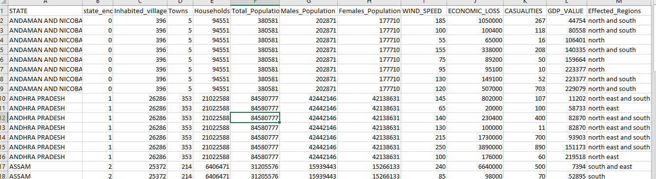
Data Integration
We start by integrating population data for all states, including key demographic metrics like total population count, gender distribution, and household numbers. Following this, we include GDP data for all states, offering economic indicators such as gross domestic product values, sectoral contributions, and growth rates. Finally, we integrate a historical cyclone dataset spanning five decades, capturing vital information on cyclone occurrences, affected regions, intensity, duration, casualties, and property losses.

Slide 13
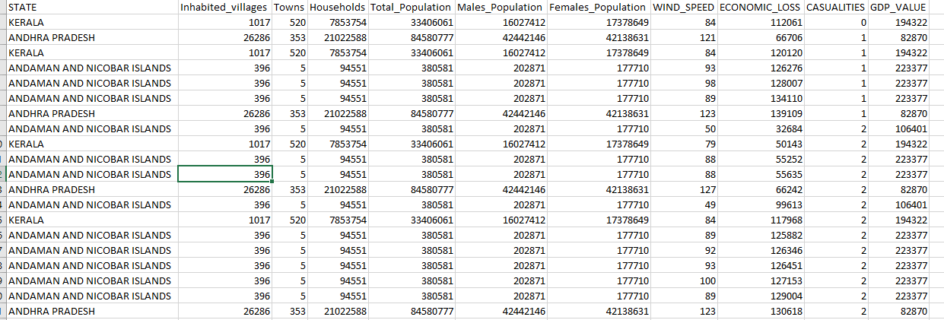
Custom Data Generation
Recognizing the challenge posed by the scarcity of historical data, we took proactive steps to develop a custom dataset. By carefully adding elements of randomness with insights from existing data, we created a comprehensive dataset that closely mirrors real-world cyclone occurrences. This innovative approach not only compensates for data limitations but also enriches our model with diverse scenarios, enhancing its predictive capabilities.

Slide 14
Feature Selection
Feature selection was conducted by thoroughly analyzing the relationship between each feature and the target variables, which are the number of casualties and property losses resulting from cyclones. The objective was to identify features that have the strongest association with the outcomes and are most informative for predicting the impact of cyclones.
For casualty prediction,
'wind speed', 'Total Population', 'Males Population', 'Females Population', and 'number of Households’
were identified as highly relevant features. These features encompass various aspects of population demographics and cyclone intensity, suggesting that densely populated regions with higher wind speeds are more susceptible to casualties during cyclones.

Slide 15
Feature Selection
For Property loss prediction
'wind speed', 'GDP value', 'number of Inhabited villages', and 'number of Towns’
emerged as significant predictor features. These features represent economic and infrastructural factors that contribute to the vulnerability of areas to property damage caused by cyclones, such as the economic prosperity of the region and the density of human settlements

Slide 16
Model Selection
The model selection process involved assessing various machine learning algorithms to identify the most suitable one for predicting cyclone casualties and property losses in India. Linear Regression, Random Forest, XGBoost, and Light GBM were among the algorithms evaluated.
These models underwent training and testing on a comprehensive dataset that integrated population demographics, GDP figures, historical cyclone attributes, and casualty and property loss records.
After thorough comparison, the Random Forest model consistently emerged as the top performer across both real and synthetic datasets.

Slide 17
Database Management
Database management involves the systematic organization and maintenance of data within a structured database system. For the Cyclone Casualty and Property Loss Prediction model, a MongoDB database was chosen to store vital information pertaining to each state of India.
This information encompasses a wide array of data, including population demographics, economic indicators like GDP figures, historical records of cyclones, and details about affected regions

Slide 18
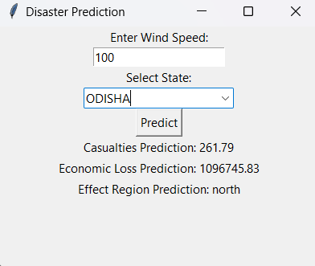
GUI Development
The GUI was intricately designed to seamlessly integrate with a MongoDB database, where comprehensive data about each state of India is stored. This database contains crucial information such as population demographics, GDP statistics, historical cyclone records, and other relevant geographical features necessary for accurate predictions.
Through Python programming, the graphical interface was constructed using libraries like Tkinter which offer robust tools for building windows, buttons, text fields, and other interactive components.

Slide 19
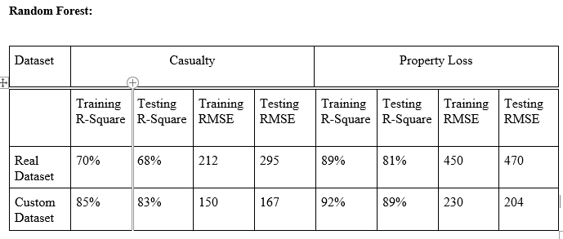
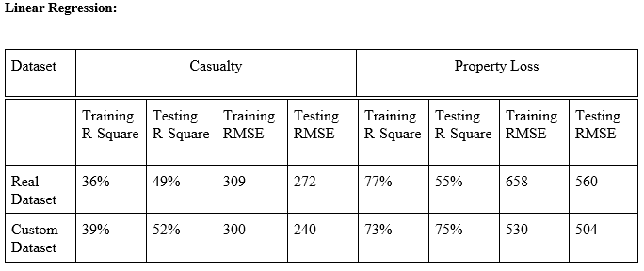
Result Analysis

Slide 20
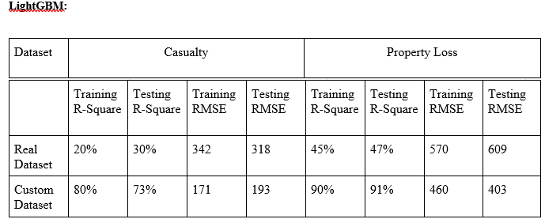
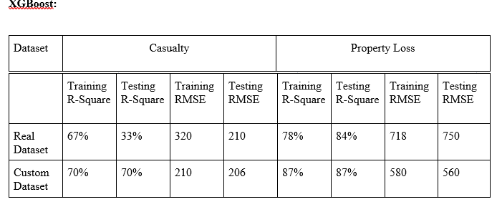
Result Analysis

Slide 21
Method - 2

Slide 22
EXPLANATION
The objective of our project is to predict property loss and casualties resulting from cyclones by leveraging a comprehensive set of features, including state-specific information such as latitude, longitude, wind speed, historical property loss and casualty data, area, and GDP of each state. By simultaneously training and testing the model for both property loss and casualty, we enhance the model's accuracy, recognizing the interdependence between these two outcomes. Utilizing the Random Forest algorithm, known for its efficiency and robustness in handling complex datasets, we ensure precise and reliable predictions. The results are complemented with a detailed set of precautionary measures to be followed in the event of a cyclone, thereby aiding in effective disaster preparedness and response.

Slide 23
FEATURE SELECTION
Maximum Wind Speed:
Use: Higher wind speeds are typically associated with more severe damage and greater potential for casualties.
Geographic Coordinates (Latitude and Longitude):
Use: The coordinates help pinpoint the exact area affected, allowing for targeted response and accurate predictions.
Population Density in Affected Area:
Use: Higher population density areas are at greater risk, and it helps estimate potential casualties.
Historical Cyclone Data (Past Events, Impacts):
Use: Historical data helps in understanding patterns, trends, and potential impacts based on similar events.
Socio-Economic Factors(GDP of Each State):
Use: This data provides us the GDP of each state over the years.

Slide 24
MODEL SELECTION
We chose a Random Forest Regression model for prediction.
This model is robust and effective for handling complex relationships in data.
The model learns from the data to estimate property loss and casualties based on wind speed and other important features.
However we have also incorporated Linear Regression algorithm as a separate model for generating the prediction , but Random Forest algorithm gave more accurate results.

Slide 25
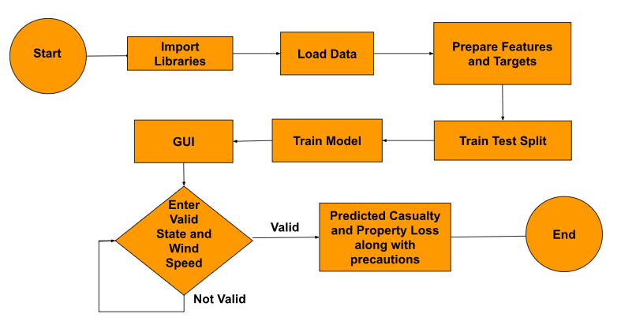
FLOWCHART

Slide 26
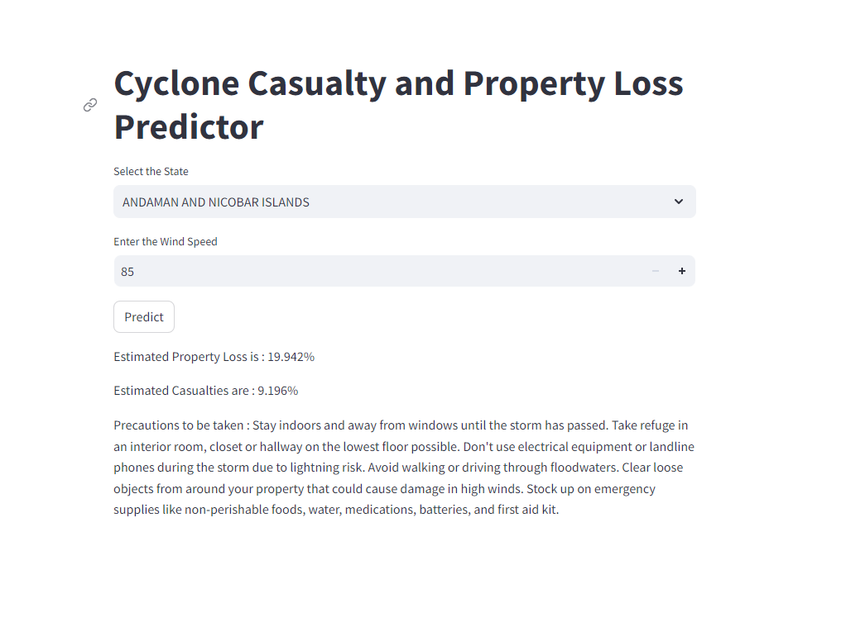
GUI IMPLEMENTATION
This is a user-friendly interface for interacting with “Cyclone Casualty and Property Loss Predictor”, which is prepared using Streamlit .Users can choose a state from a dropdown menu and enter wind speed. This interface predicts the potential property loss and casualties based on the selected state and wind speed, while also offering valuable safety guidelines to follow during a cyclonic event.

Slide 27
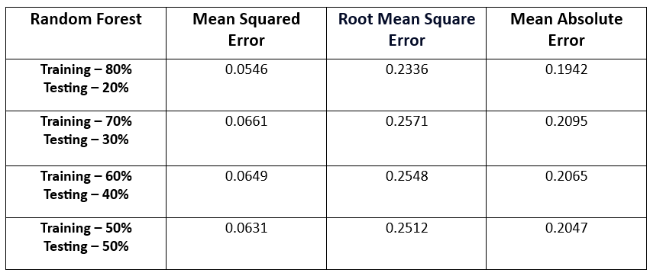

RESULT COMPARISON
Note: Greater the accuracy more the value tends towards zero.

Slide 28
Applications
Early Warning Systems: Enhancing timely warnings for evacuation and preparedness.
Resource Allocation: Efficiently directing resources to affected areas.
Infrastructure Resilience: Guiding resilient infrastructure planning.
Climate Change Adaptation: Preparing for changing cyclone patterns.
Disaster Recovery: Guiding post-cyclone recovery efforts.
Humanitarian Response: Coordinating relief efforts during and after cyclones.

Slide 29
Conclusion
In conclusion, the development of a Cyclone Casualty and Property Loss Prediction model for India
represents a significant step towards enhancing disaster preparedness and response strategies. By
integrating diverse datasets, leveraging machine learning algorithms, and designing a user-friendly
interface, this project offers valuable insights into the potential impact of cyclones on human lives and property.

Slide 30
Future Work
Refinement of Predictive Models: Continuous optimization, including ensemble methods and deep learning, enhances accuracy.
Integration of Additional Data Sources: Incorporating satellite imagery and climate data enriches predictions.
Enhancement of User Interface: Iterative improvements based on feedback enhance usability.
Real-time Data Integration: Developing mechanisms for real-time analysis enables timely response.

Slide 31
INDIVIDUAL CONTRIBUTION(Method-1)
SATARUPA:
Collect and merge the datasets.
Added noise to the synthetic dataset for increased robustness.
Model implementation for both casualty and property loss using Linear Regression and Random Forest.
Train and test the models on both real data and synthetic data.
Hyperparameter tuning and Feature selection to increase the accuracy of the models.
SRIJIT:
Implemented a user-friendly GUI with key parameter labels.
Integrated the GUI with MongoDB.
Generated synthetic datasets from real data to enhance model robustness.
Conducted model training for both casualty and property loss using gradient boosting algorithms.

Slide 32
INDIVIDUAL CONTRIBUTION(Method-2)
Pratiksha Naskar :
Dataset Collection, Creation of Historical Data.
Database Creation Using Mongo DB.
Confusion Matrix , Comparison of Results
Model Code for both property loss and casualty prediction using random forest and linear regression
GUI Implementation
Sayan Das :
Dataset Collection, Creation of Historical Data, Dataset Merging.
Preprocessing of Data(Normalisation, Datatype Change).
Model Code for both property loss and casualty prediction using random forest and linear regression
GUI Implementation.
Evaluation Metrics.

Slide 33
THANK YOU

